Slide 1
6
Arrays
Objectives
In this chapter, you’ll:
Use the array data structure to represent lists and tables of values.
Define arrays, initialize arrays and refer to individual elements of arrays.
Define symbolic constants.
Pass arrays to functions.
Use arrays to store, sort and search lists and tables of values.
Be introduced to data science using basic descriptive statistics, such as mean, median and mode.
Define and manipulate multidimensional arrays.
Create variable-length arrays whose size is determined at execution time.
Understand security issues related to input with scanf, output with printf and arrays.

Slide 2
6.1 Introduction
Arrays are data structures consisting of related data items of the same type.
C’s language includes a notion of struct—a data structure consisting of related data items of possibly different types.
Arrays and structs are “static” entities in that they remain the same size throughout their lifetimes.

Slide 3
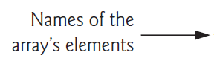
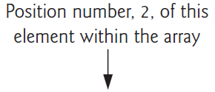

6.2 Arrays
An array is a group of elements of the same type stored contiguously in memory.
To refer to a particular location or element in the array, we specify the array’s name, followed by the element’s position number in square brackets ([]).
The first element is located at position number 0 (zero). The position number is called the element’s subscript (or index). A subscript must be a non-negative integer or integer expression.

Slide 4
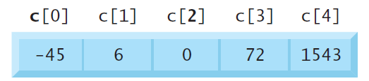
6.2 Arrays
An array is a group of elements of the same type stored contiguously in memory.

Slide 5
6.2 Arrays
An array is a group of elements of the same type stored contiguously in memory.

Slide 6
6.2 Arrays
An array is a group of elements of the same type stored contiguously in memory.

Slide 7
6.3 Defining Arrays
When you define an array, you specify its element type and number of elements so the compiler may reserve the appropriate amount of memory. The following definition reserves five elements for integer array c, which has subscripts in the range 0–4.
int c[5];
The definitions
int b[100];
int x[27];

Slide 8
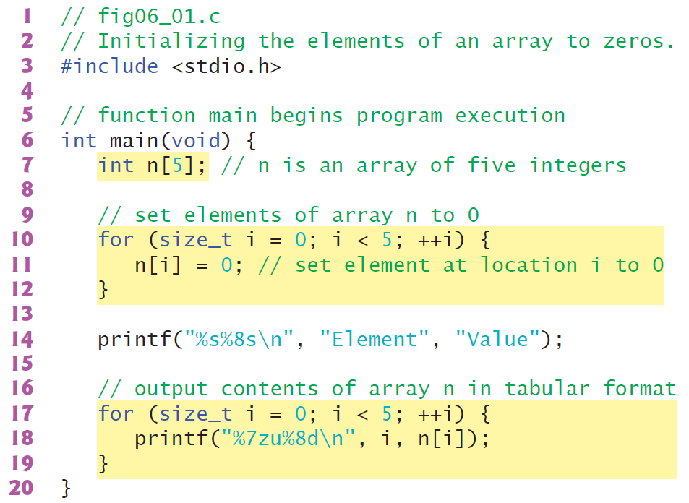
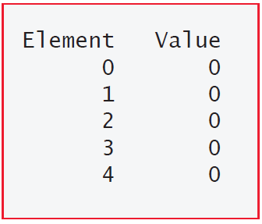
6.4 Array Examples
6.4.1 Defining an Array and Using a Loop to Set the Array’s Element Values

Slide 9
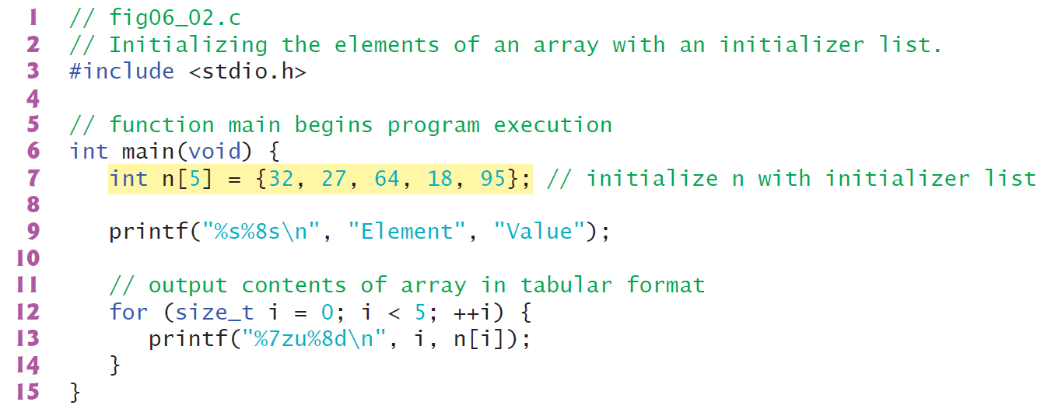
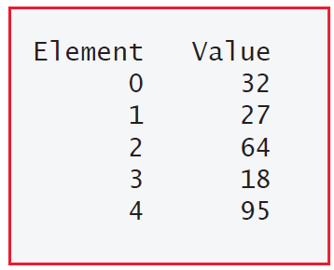
6.4 Array Examples
6.4.2 Initializing an Array in a Definition with an Initializer List

Slide 10
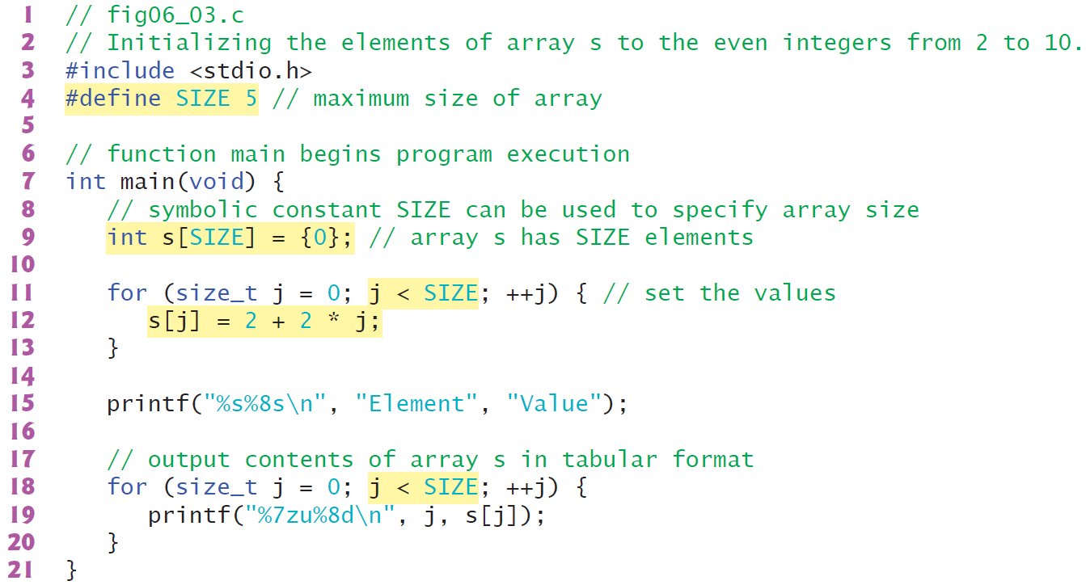
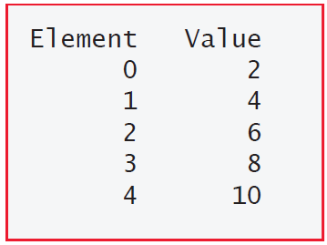
6.4 Array Examples
6.4.3 Specifying an Array’s Size with a Symbolic Constant and Initializing Array Elements with Calculations

Slide 11
5.2 Modularizing Programs in C
Defining Functions
Functions are invoked by a function call, which specifies the function name and provides information (as arguments) that the function needs to perform its designated task.
A common analogy for this is the hierarchical form of management. A boss (the calling function or caller) asks a worker (the called function) to perform a task and report back when it’s done.
Function printf displays the data and reports back—or returns—to the caller when it completes its task.

Slide 12
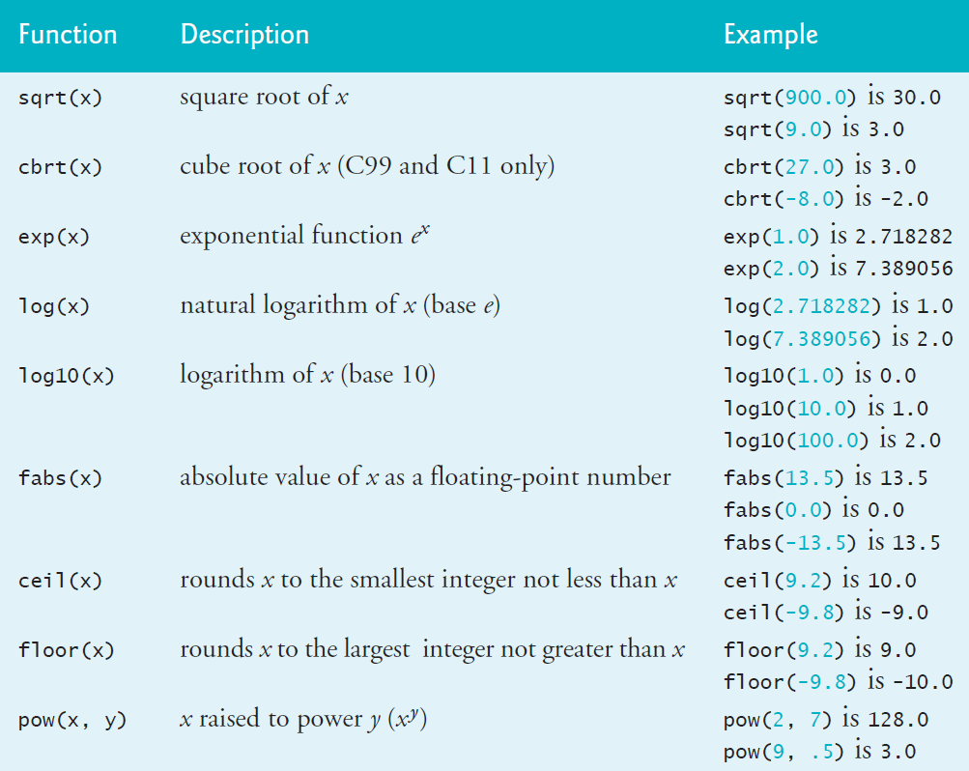
5.3 Math Library Functions
C’s math library functions (header math.h) allow you to perform common mathematical calculations.
We use many of these functions in this section.
To calculate and print the square root of 900.0 you might write
printf("%.2f", sqrt(900.0));

Slide 13
5.4 Functions
Functions allow you to modularize a program. In programs containing many functions, main is often implemented as a group of calls to functions that perform the bulk of the program’s work.
Functionalizing Programs
There are several motivations for “functionalizing” a program. The divide-and-conquer approach makes program development more manageable.
Another motivation is building new programs by using existing functions. Such software reusability is a key concept in object-oriented programming languages derived from C, such as
C++,
Java,
C# (pronounced “C sharp”),
Objective-C and
Swift.

Slide 14
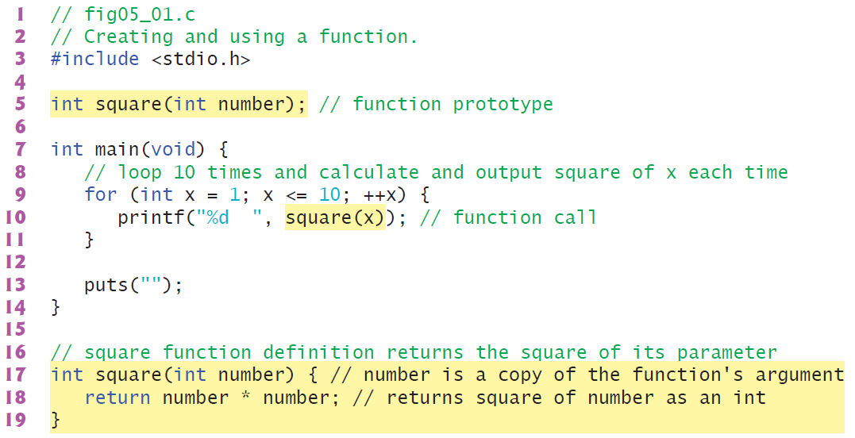
5.5 Function Definitions
Each program we’ve presented has consisted of a function called main that called standard library functions to accomplish its tasks. Now we consider how to write custom functions.
5.5.1 square Function
Consider a program that uses a function square to calculate and print the squares of the integers from 1 to 10

Slide 15
5.5 Function Definitions
Calling Function square
Function square is invoked or called in main within the printf statement (line 10):
Function square receives a copy of the argument x’s value in the parameter number (line 17).
square Function Definition
Function square’s definition (lines 17–19) shows that it expects an int parameter number.
The keyword int preceding the function name (line 17) indicates that square returns an integer result.
The return statement in square passes the result of number * number back to the calling function.

Slide 16
5.5 Function Definitions
Local Variable
All variables defined in function definitions are local variables—they can be accessed only in the function in which they’re defined.
Most functions have parameters that enable communicating between functions via arguments in function calls.
A function’s parameters are also local variables of that function.
Format of a Function Definition
The format of a function definition is
return-value-type function-name(parameter-list) {
statements
}
The function-name is any valid identifier. The return-value-type is the type of the result returned to the caller. The return-value-type void indicates that a function does not return a value. Together, the return-value-type, function-name and parameter-list are sometimes referred to as the function header.

Slide 17
5.5 Function Definitions
Local Variable
All variables defined in function definitions are local variables—they can be accessed only in the function in which they’re defined.
Most functions have parameters that enable communicating between functions via arguments in function calls.
A function’s parameters are also local variables of that function.
Format of a Function Definition
The format of a function definition is
return-value-type function-name(parameter-list) {
statements
}
The function-name is any valid identifier. The return-value-type is the type of the result returned to the caller. The return-value-type void indicates that a function does not return a value. Together, the return-value-type, function-name and parameter-list are sometimes referred to as the function header.

Slide 18
5.5 Function Definitions
Function Body
The statements within braces form the function body, which also is a block. Local variables can be declared in any block, and blocks can be nested. Functions cannot be nested—defining a function inside another function is a syntax error.
Returning Control from a Function
There are three ways to return control from a called function to the point at which a function was invoked. If the function does not return a result, control is returned simply when the function-ending right brace is reached, or by executing the statement
return;
If the function does return a result, the statement
return expression;
returns the expression’s value to the caller.

Slide 19
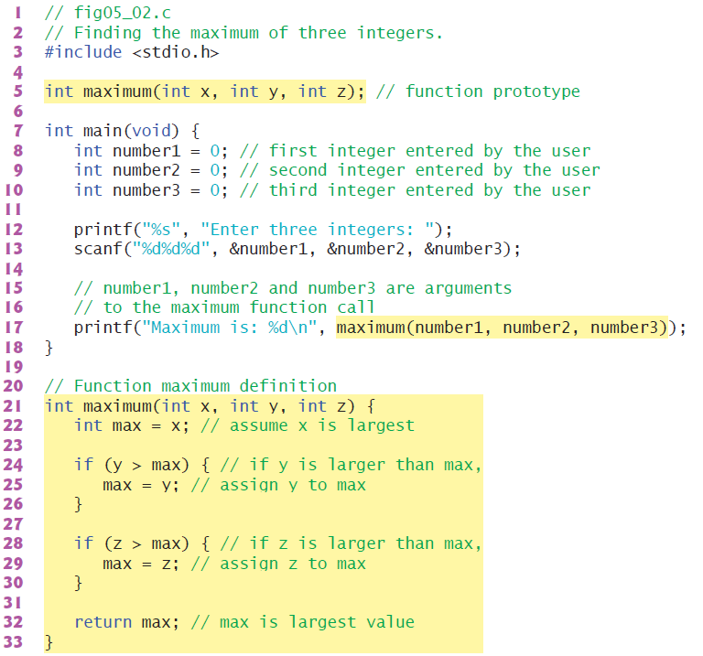
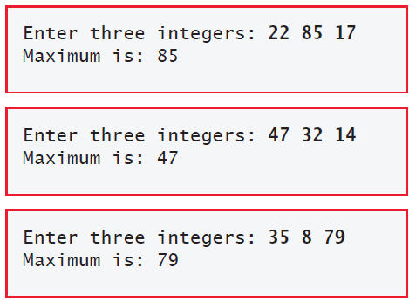
5.5 Function Definitions
5.5.2 maximum Function

Slide 20
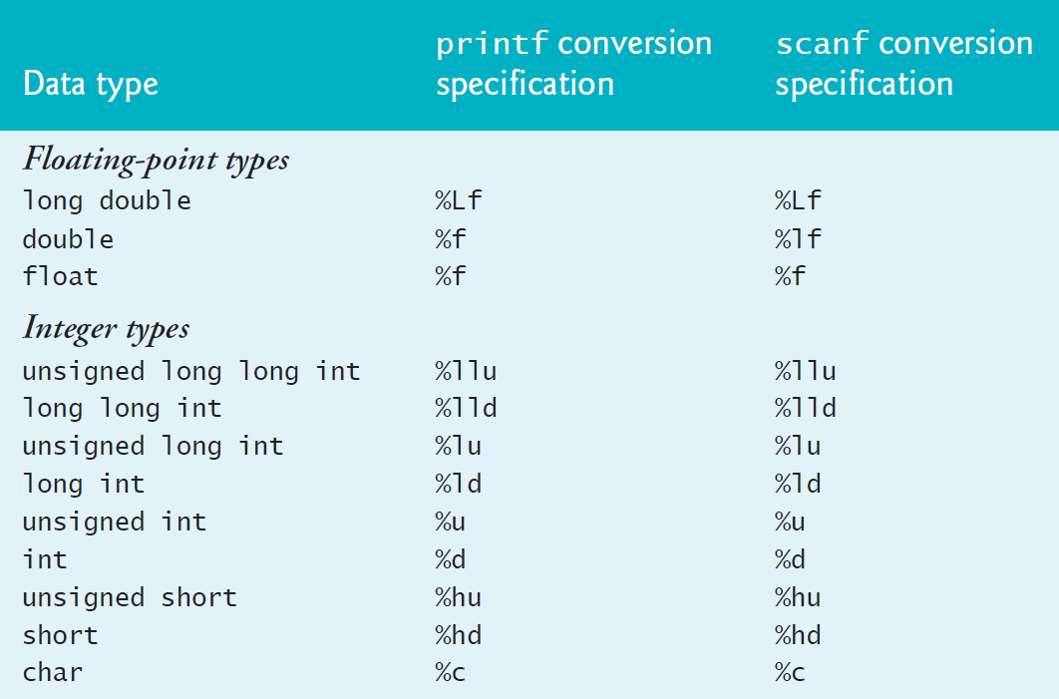
Mixed-Type Expressions

Slide 21
5.7 Function-Call Stack and Stack Frames
To understand how C performs function calls, we first need to consider a data structure (i.e., collection of related data items) known as a stack. Think of a stack as analogous to a pile of dishes.
You usually place a dish at the top—referred to as pushing the dish onto the stack.
Similarly, you typically remove a dish from the top—referred to as popping the dish off the stack.
Stacks are known as last-in, first-out (LIFO) data structures—the last item pushed (inserted) on the stack is the first item popped (removed) from the stack.

Slide 22
5.7 Function-Call Stack and Stack Frames
To understand how C performs function calls, we first need to consider a data structure (i.e., collection of related data items) known as a stack. Think of a stack as analogous to a pile of dishes.
You usually place a dish at the top—referred to as pushing the dish onto the stack.
Similarly, you typically remove a dish from the top—referred to as popping the dish off the stack.
Stacks are known as last-in, first-out (LIFO) data structures—the last item pushed (inserted) on the stack is the first item popped (removed) from the stack.

Slide 23
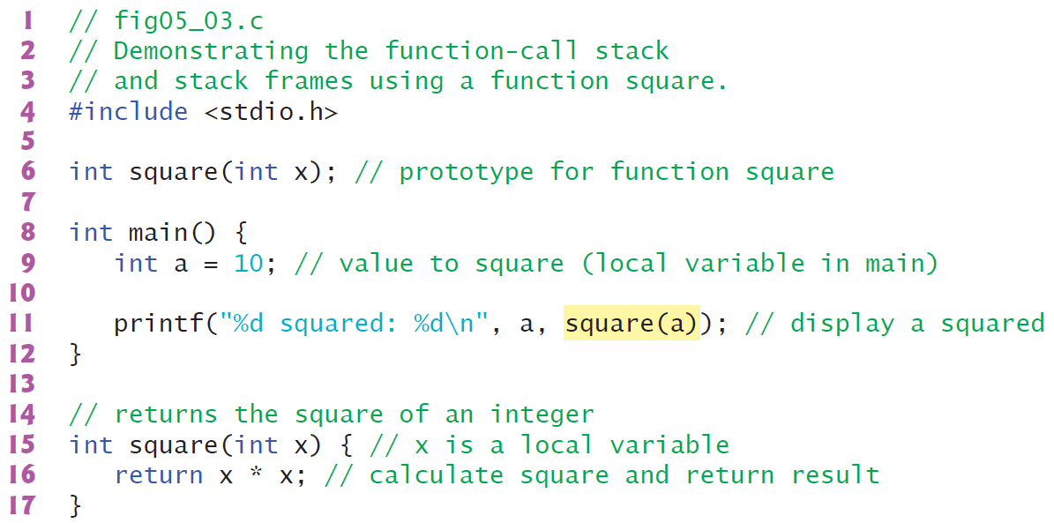
5.7 Function-Call Stack and Stack Frames

Slide 24
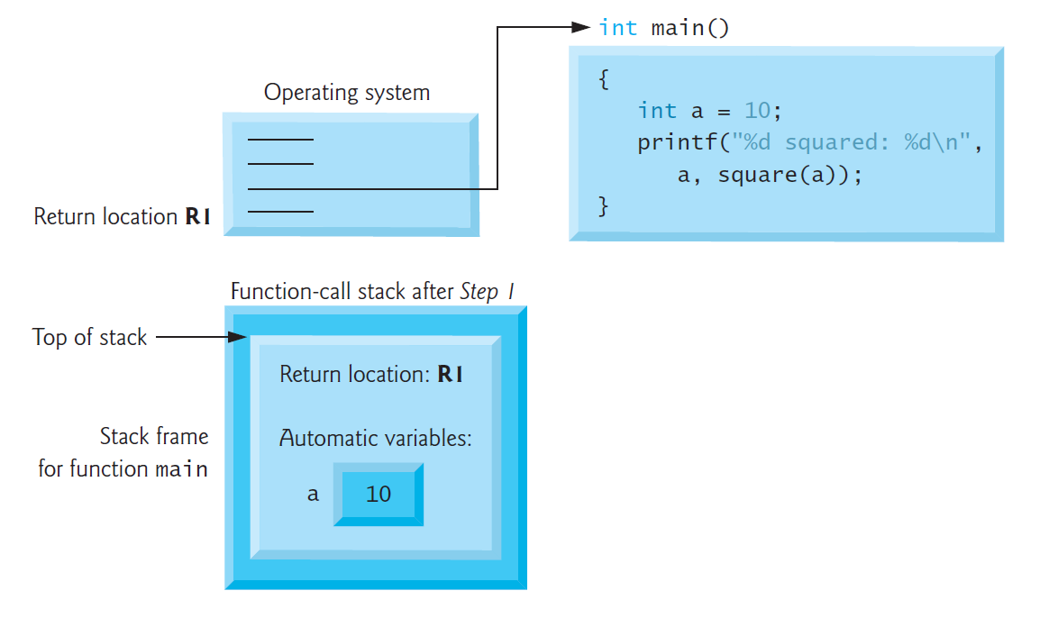
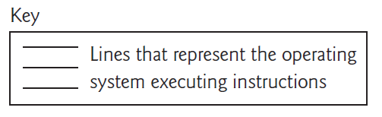
5.7 Function-Call Stack and Stack Frames
Step 1: Operating System Invokes main to Execute Application

Slide 25
5.7 Function-Call Stack and Stack Frames
Step 1: Operating System Invokes main to Execute Application

Slide 26
5.7 Function-Call Stack and Stack Frames
Step 1: Operating System Invokes main to Execute Application

Slide 27
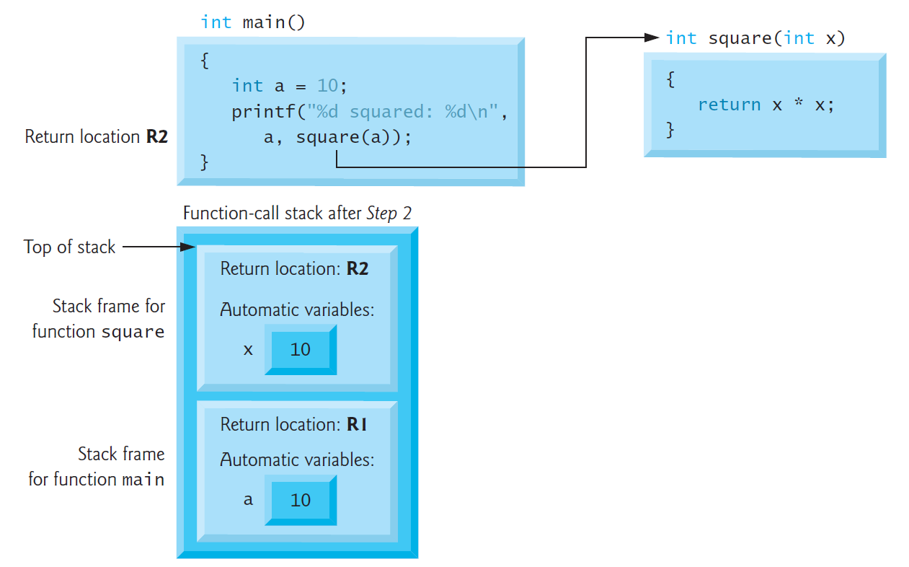
5.7 Function-Call Stack and Stack Frames
Step 2: main Invokes Function square to Perform Calculation

Slide 28
5.7 Function-Call Stack and Stack Frames
Step 2: main Invokes Function square to Perform Calculation

Slide 29
5.7 Function-Call Stack and Stack Frames
Step 2: main Invokes Function square to Perform Calculation

Slide 30
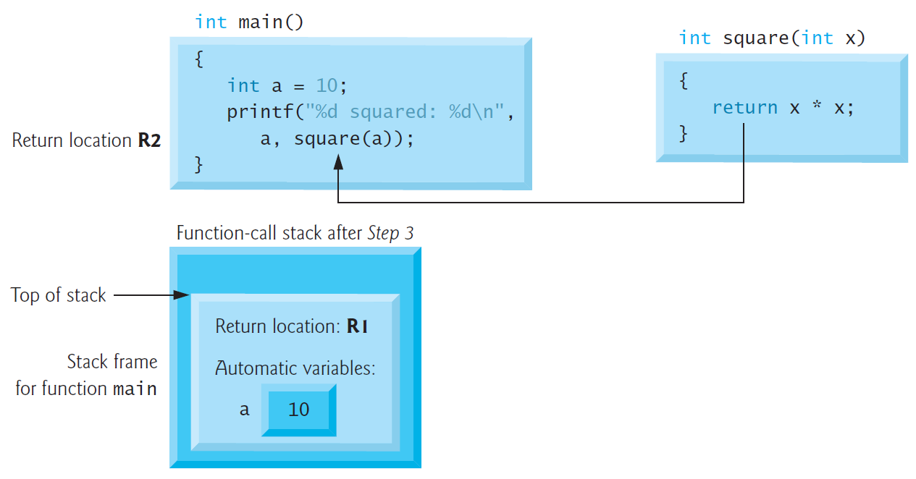
5.7 Function-Call Stack and Stack Frames
Step 3: square Returns Its Result to main

Slide 31
5.7 Function-Call Stack and Stack Frames
Step 3: square Returns Its Result to main

Slide 32
5.7 Function-Call Stack and Stack Frames
Step 3: square Returns Its Result to main

Slide 33
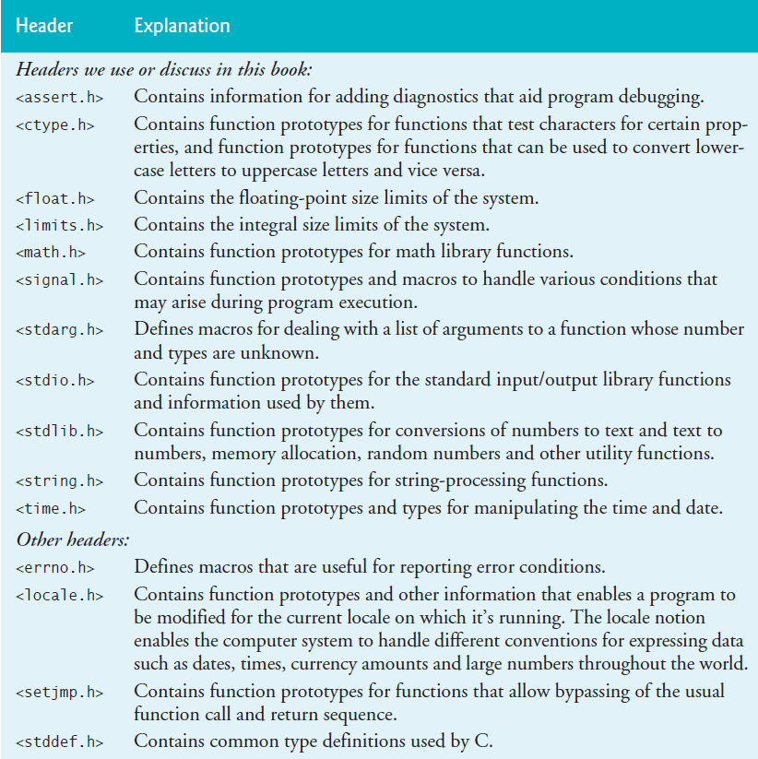
5.8 Headers

Slide 34
5.8 Headers

